Slide 1


Foundations of
Scientific Computing
(SciComp 101)
Dave Biersach
dbiersach@bnl.gov
Session 17
3D Graphics

Slide 2
Session 17 – Topics
Understand 3D axes in matplotlib
Plot Archimedes' Spiral in 3D using cylindrical coordinates
Understand 3D vertices and facets in matplotlib
Plot a 3D wireframe monolith using Cartesian coordinates
Plot a 3D pyramid that conforms to the Golden Ratio
Use Numpy to generate the outer product of two vectors
Relate poloidal and toroidal angles in spherical coordinates
Plot a 3D sphere using only vertices (a scatter plot)
Plot a 3D wireframe and facets of a sphere and torus
Plot the 3D surface plot of a multivariable function
Create a quiver plot using the gradient of a scalar field

Slide 3
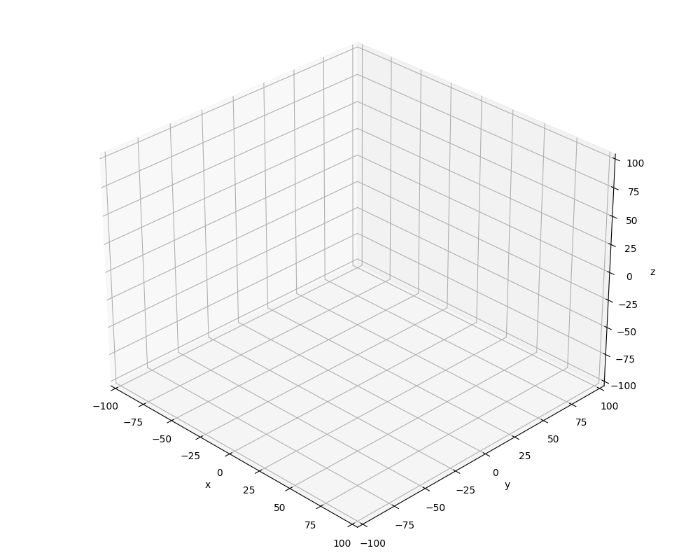
3D Cartesian Coordinates in matplotlib
$$z^{+}$$
$$y^{+}$$
$$z^{+}$$
$$x^{+}$$
$$\left(0,0,0\right)$$
$$y^{+}$$
$$x^{+}$$

Slide 4
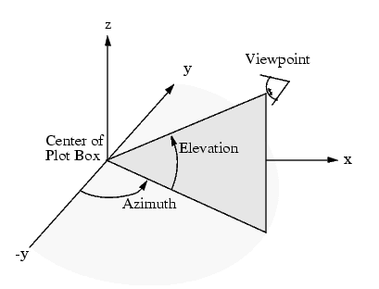
Viewing Angles in matplotlib
Default view angles:
$$azim={−60}^{°}$$
$$elev= {30}^{°}$$

Slide 5
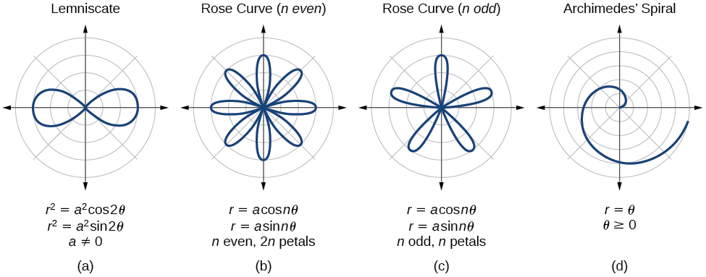
Parametric Curves
The two parameters a, n are used to calculate the current radius $r$ as $θ$sweeps the circle

Slide 6
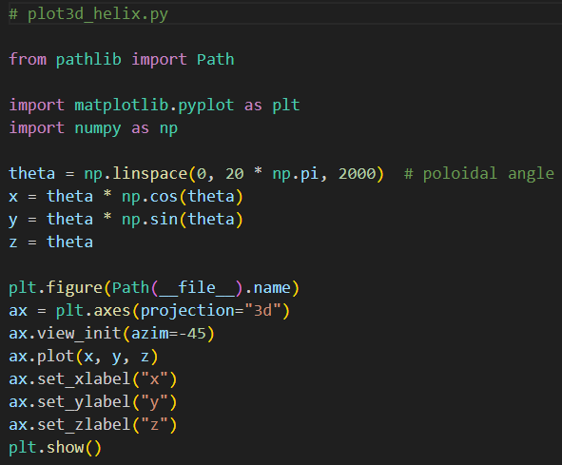
Open plot3d_helix.py
DO NOT edit
this code
$$\left(θ\cos{θ},θ\sin{θ},θ\right)$$
$$0≤θ≤20π$$
①
②
Cylindrical to Cartesian Coordinate Conversion
③
④
⑤
⑥
Can only set z-axis label on an ax object (not plt)
⑦

Slide 7
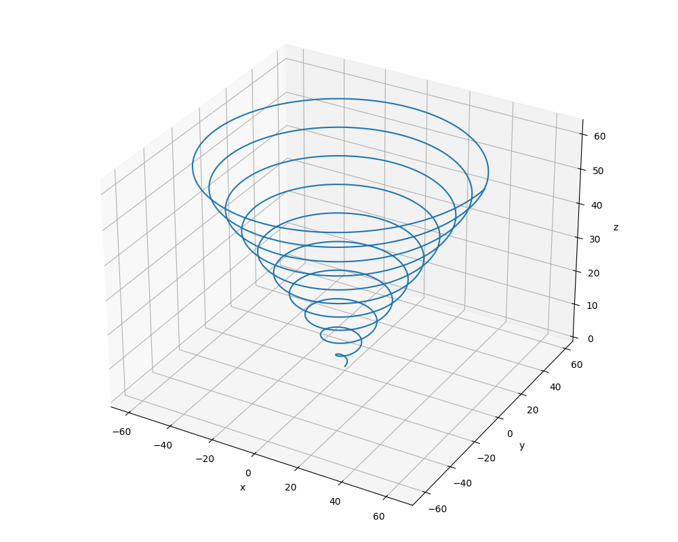
Run plot3d_helix.py
Left-click and drag to rotate the plot
$$\left(θ\cos{θ},θ\sin{θ},θ\right)$$
$$0≤θ≤20π$$

Slide 8
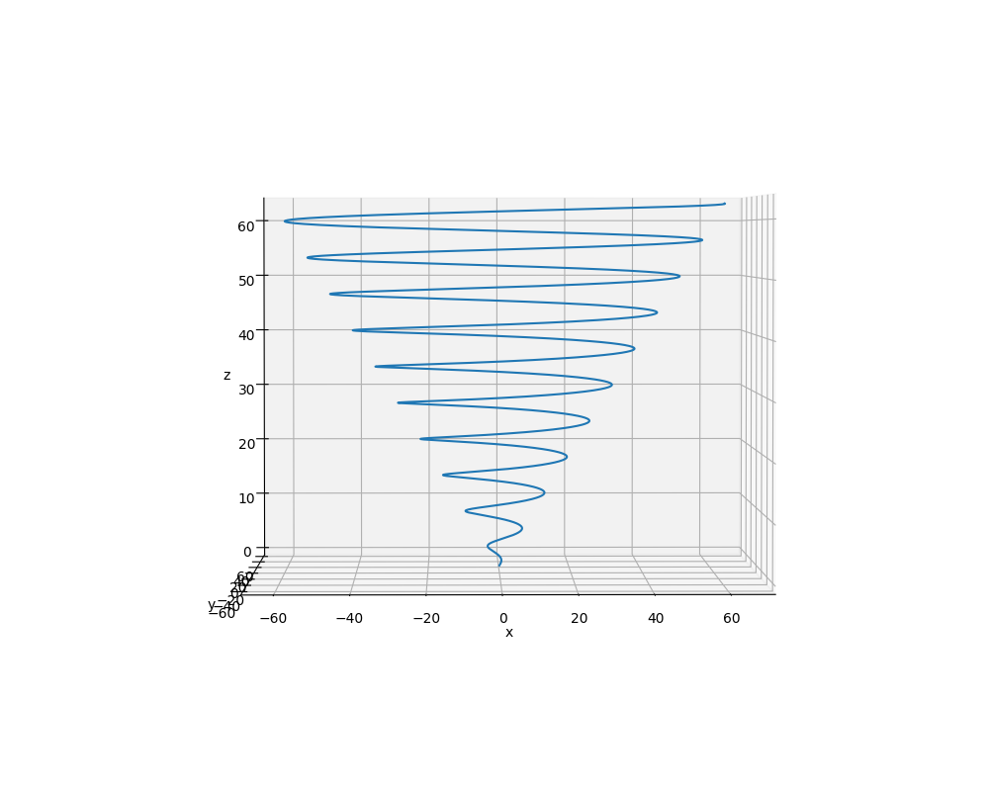
Run plot3d_helix.py
$$z→20π \sim z→62.8$$
$$\left(θ\cos{θ},θ\sin{θ},θ\right)$$
$$0≤θ≤20π$$

Slide 9
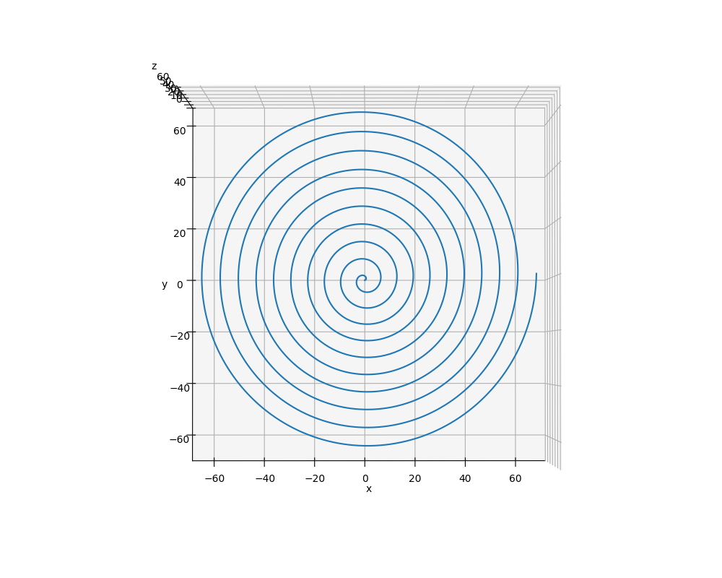
Run plot3d_helix.py
$$x=θ cos{θ}$$
$$y=θ sin{θ}$$
$$0≤θ≤20π$$

Slide 10
3D Axes in matplotlib
Constructing a 3D plot (Cartesian coordinates) using matplotlib can be done using two different approaches:
Define a set of 3D vertices and then manually group these vertices into facets
This approach gives maximal rendering control but is slower
Leverages the capabilities of Poly3DCollection
Provide three arrays containing the $x, y, z$ vertices and then let matplotlib determine how best to connect them
No lines connecting the points = scatter plot
Only lines connecting the points = wireframe
Filled polygons connecting nearby points = surface plot

Slide 11
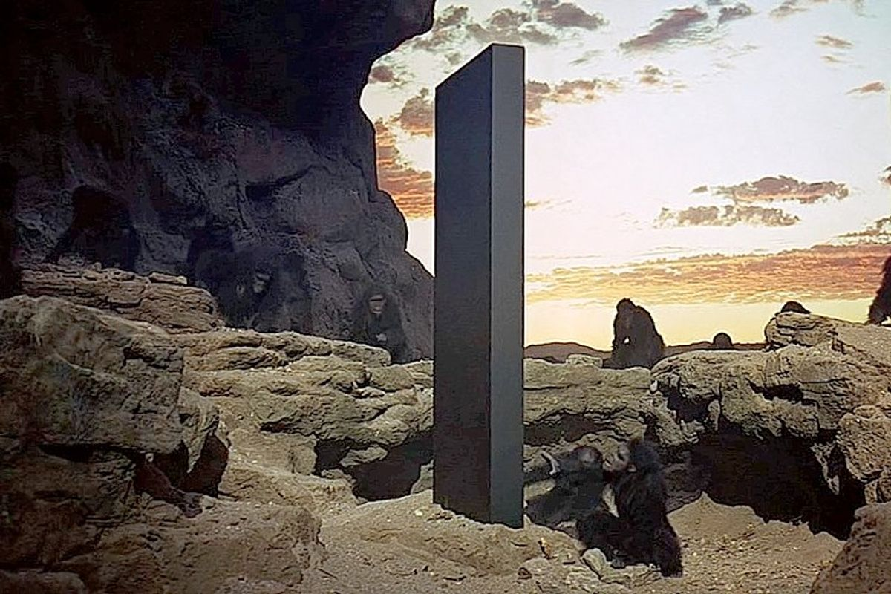
Drawing a Monolith

Slide 12
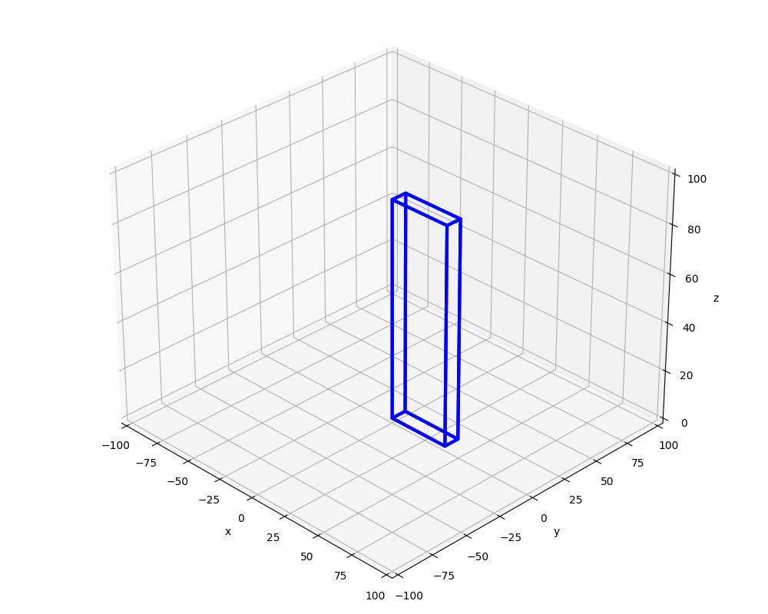
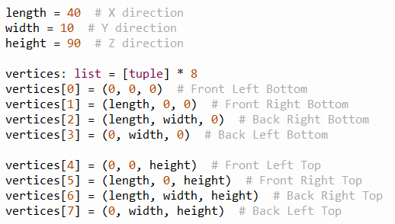
3D Cartesian Coordinates in matplotlib
⑦
④
$$length$$
⑥
⑤
$$height$$
$$length$$
③
$$width$$
⓪
②
①

Slide 13
3D Cartesian Coordinates in matplotlib
①
⑤
②
③
⓪
④

Slide 14
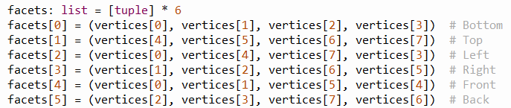
3D Cartesian Coordinates in matplotlib
⑦
④
①
⑥
⑤
⑤
②
③
③
⓪
⓪
②
④
①

Slide 15
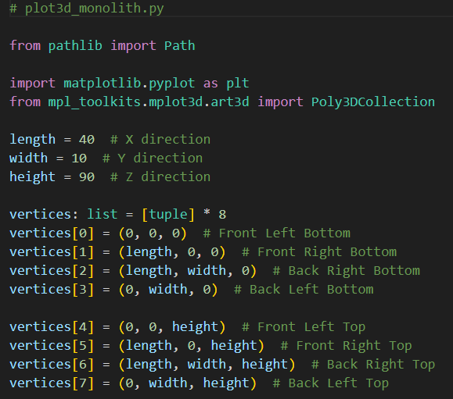
Open plot3d_monolith.py
①
②
Reserve space for 8 tuples in the list
③

Slide 16
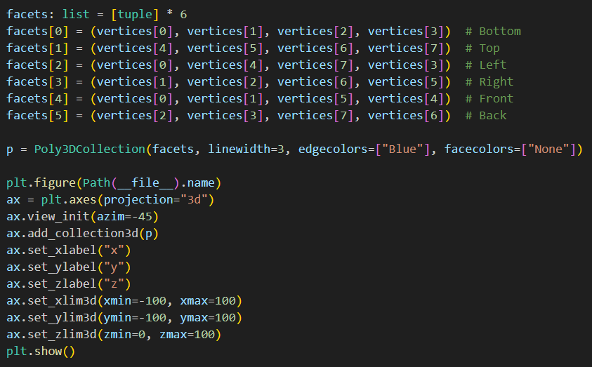
View plot3d_monolith.py
①
Reserve space for 6 tuples in the list
This will make a wireframe drawing
②
③
④
⑤

Slide 17

Run plot3d_monolith.py
☺

Slide 18
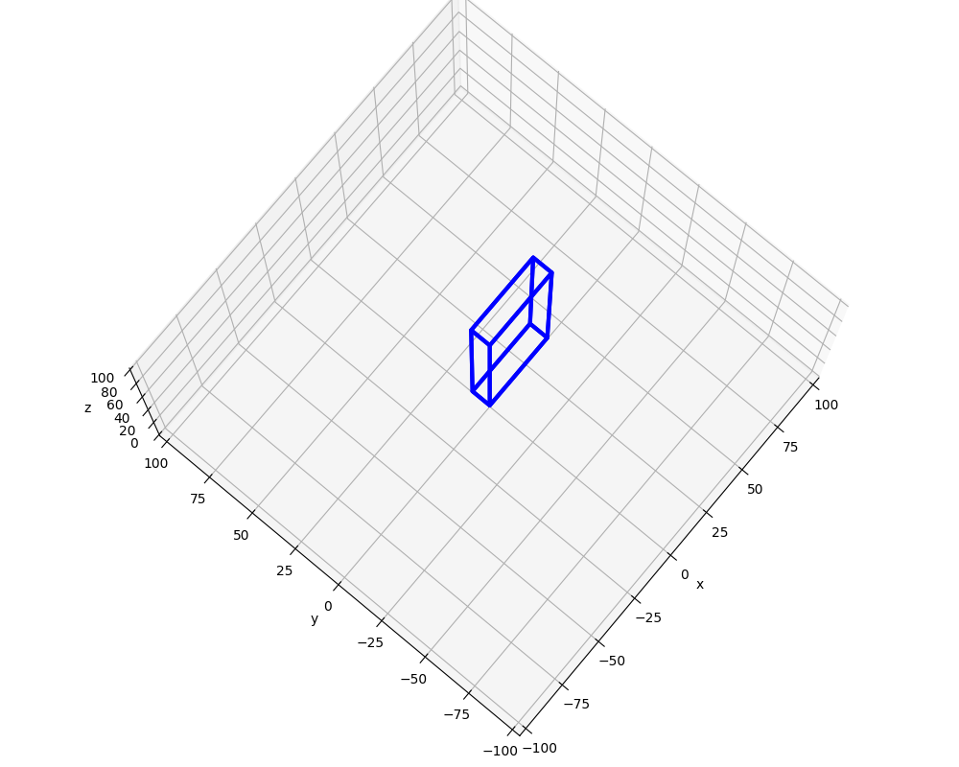
Run plot3d_monolith.py
Left-click and drag to rotate the plot

Slide 19
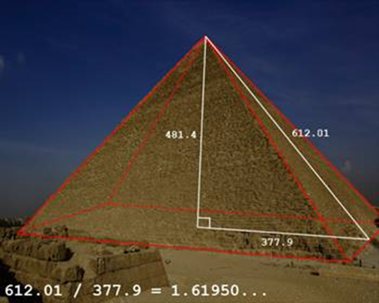
Drawing a Pyramid
Draw a pyramid with $length=width=150$ and $height=length ∗ φ$
lowercase phi

Slide 20
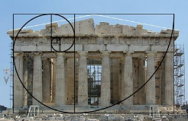

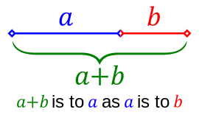
The Golden Ratio
$$1+ \frac{1}{φ}=φ$$
$$φ+1=φ^{2}$$
lowercase
phi
$$\frac{a+b}{a}=\frac{a}{b}=φ$$
$$φ^{2}−φ−1=0$$
$$1+ \frac{b}{a}=\frac{a}{b}=φ$$
$$φ=\frac{1+\sqrt{5}}{2}=1.6180339887…$$

Slide 21
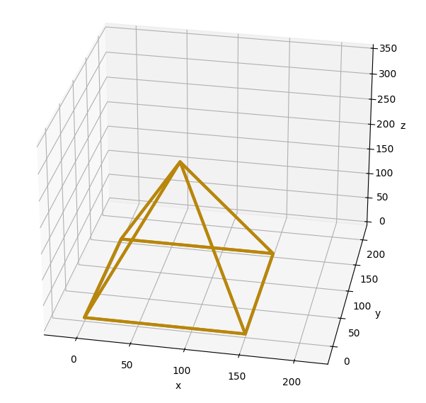
Drawing a Pyramid
④
④
③
①
③
②
⓪
⓪
②
①
$$length=width=150, height=length ∗ φ$$

Slide 22
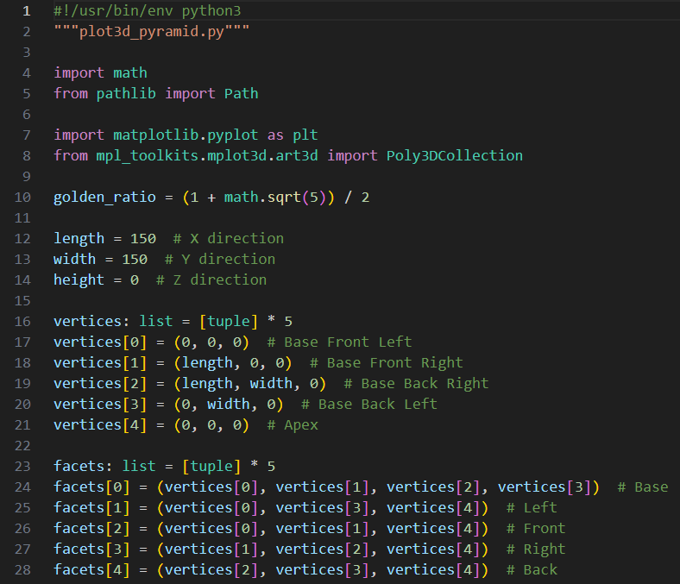
Open plot3d_pyramid.py
DO NOT edit
this code
①
②
③
④
⑤
⑥

Slide 23
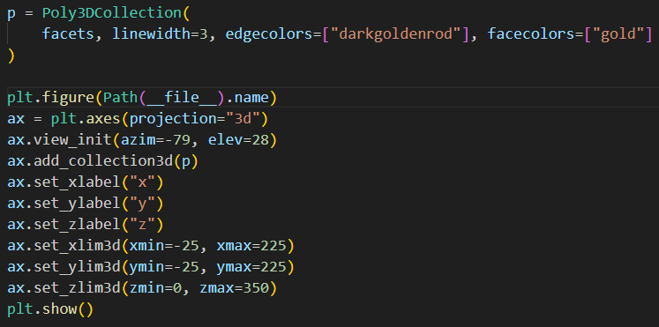
View plot3d_pyramid.py
①
②
③
④

Slide 24
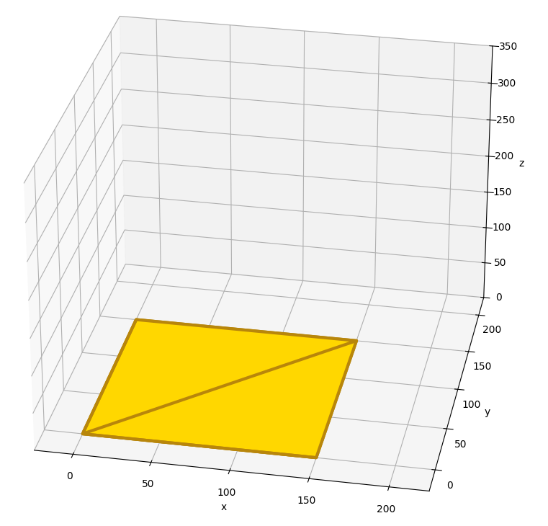
Run plot3d_pyramid.py
☹

Slide 25
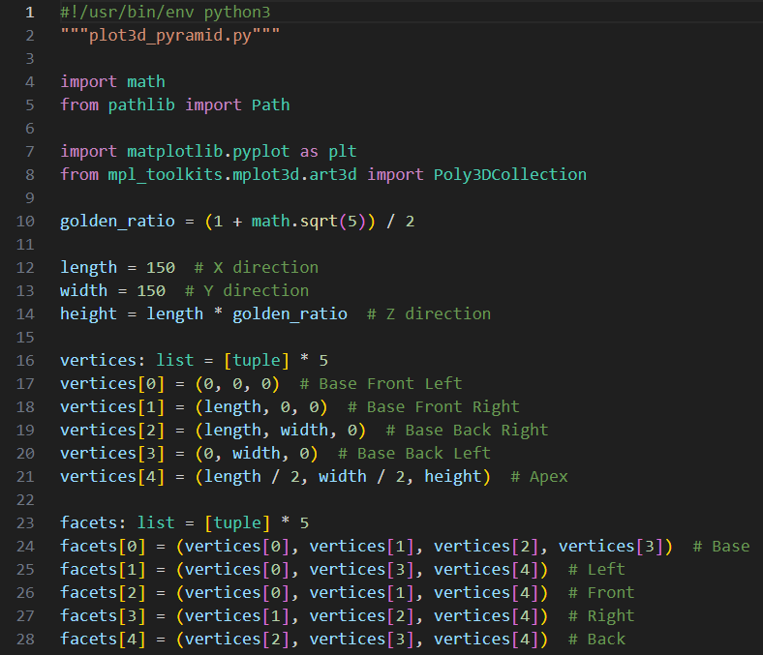
Edit plot3d_pyramid.py
You must type in this code
①
②

Slide 26
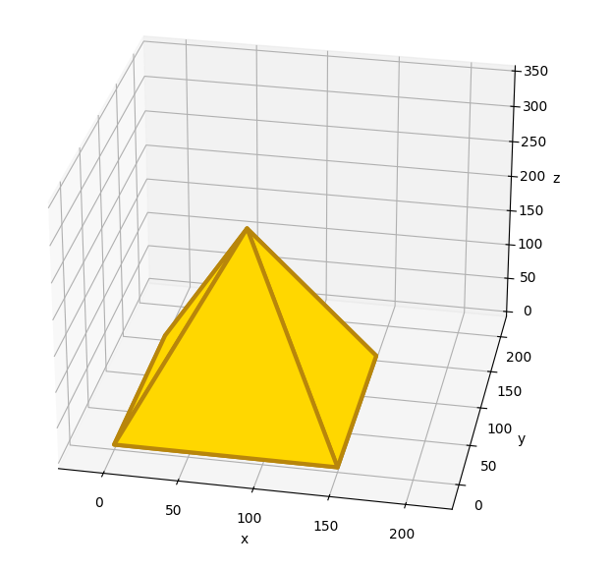
Run plot3d_pyramid.py
☺

Slide 27
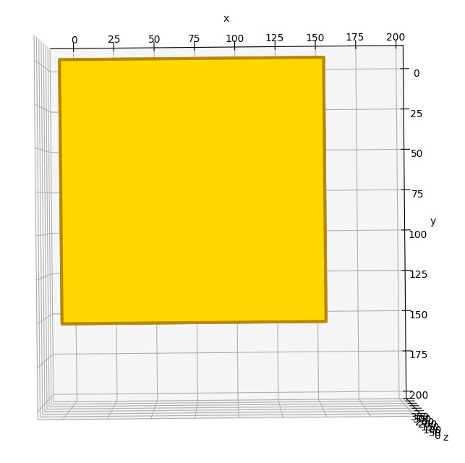
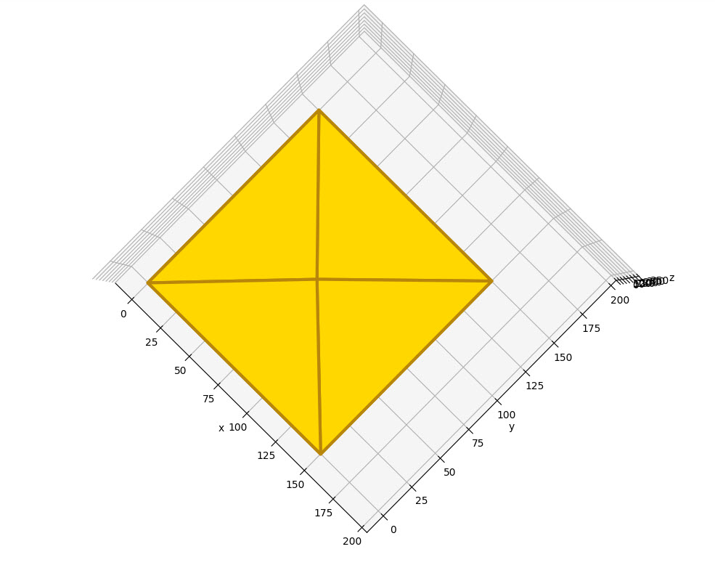
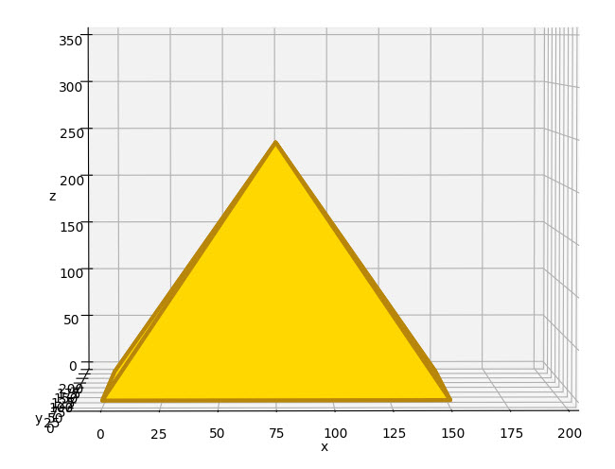
View plot3d_pyramid.py
Left-click and drag to rotate the plot

Slide 28
3D Axes in matplotlib
Constructing a 3D plot (Cartesian coordinates) using matplotlib can be done using two different approaches:
Define a set of 3D vertices and then manually group these vertices into facets
This approach gives maximal rendering control but is slower
Leverages the capabilities of Poly3DCollection
Provide three arrays containing the $x, y, z$ vertices and then let matplotlib determine how best to connect them
No lines connecting the points = scatter plot
Only lines connecting the points = wireframe
Filled polygons connecting nearby points = surface plot

Slide 29
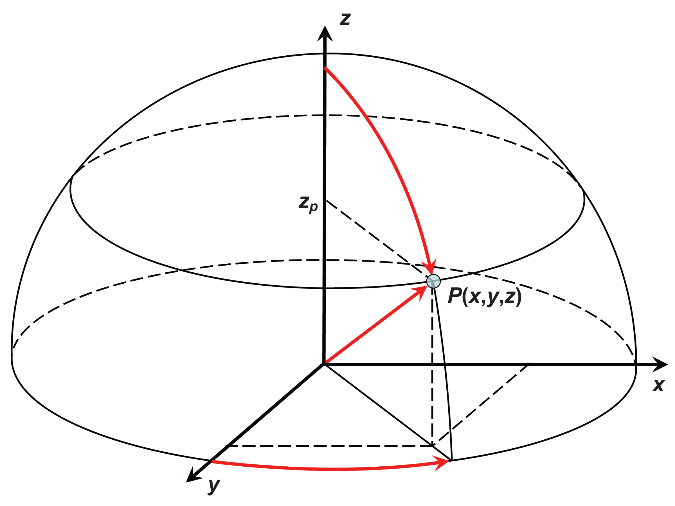
Poloidal and Toroidal Angles
$0≤u≤π⟹$ poloidal (latitude)
North to South Pole (vertical)
$0≤v≤2π⟹$ toroidal (longitude)
Around the slice (horizontal)
$R=$ radius of sphere
$R_{t}$= radius of slice
$$z=R\cos{u}$$
$$x=R_{t}\sin{v}$$
$$R_{t}=R\sin{u}$$
$$y=R_{t}\cos{v}$$
$$z$$
$$x=\sin{u}\sin{v}$$
$$y=\sin{u}\cos{v}$$
$$z=\cos{u}$$
$$R_{t}$$
$$u$$
$$R$$
$$R$$
$$x$$
$$v$$
$$R_{t}$$
For a unit sphere where $R = 1$
$$y$$

Slide 30
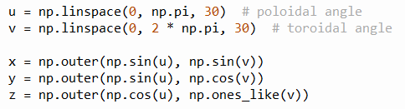
Matrices and Outer Product
$$u=(u_{1},u_{2},⋯,u_{m})$$
$$v=(v_{1},v_{2},⋯,v_{n})$$
These are matrices
$$X=sin{u}⨂\sin{v}$$
$$Y=sin{u}⨂\cos{v}$$
For matplotlib to plot(x, y, z)
all three vectors/matrices must have the same shape & size
$$Z=\cos{u}⨂1$$
For a unit sphere where $R = 1$
$$x=\sin{u}\sin{v}$$
$$y=\sin{u}\cos{v}$$
$$z=\cos{u}$$
$$a⨂b=\left[\begin{matrix}\begin{matrix}a_{1}b_{1} & a_{1}b_{2} \\ a_{2}b_{1} & a_{2}b_{2}\end{matrix} & ⋯ & \begin{matrix}a_{1}b_{n} \\ a_{2}b_{n}\end{matrix} \\ ⋮ & ⋱ & ⋮ \\ \begin{matrix}a_{m}b_{1} & a_{m}b_{2}\end{matrix} & ⋯ & a_{m}b_{n}\end{matrix}\right]$$
The outer product of two vectors produces a matrix

Slide 31
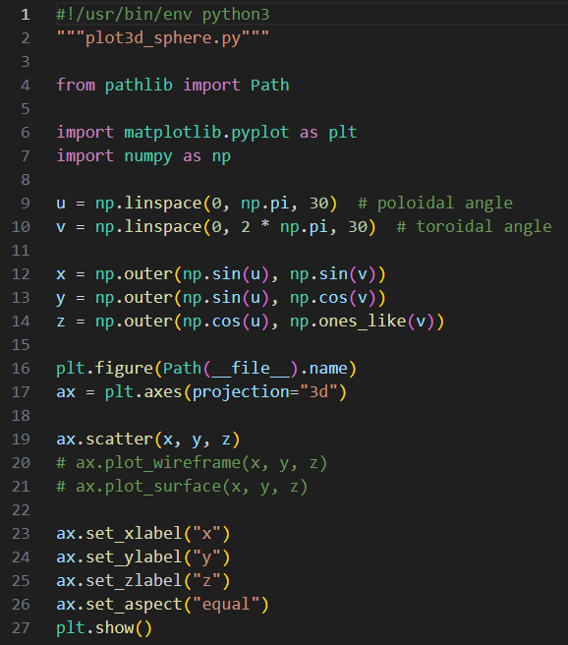
Open plot3d_sphere.py
DO NOT edit
this code
①
②
③
④
⑤
⑥
⑦

Slide 32
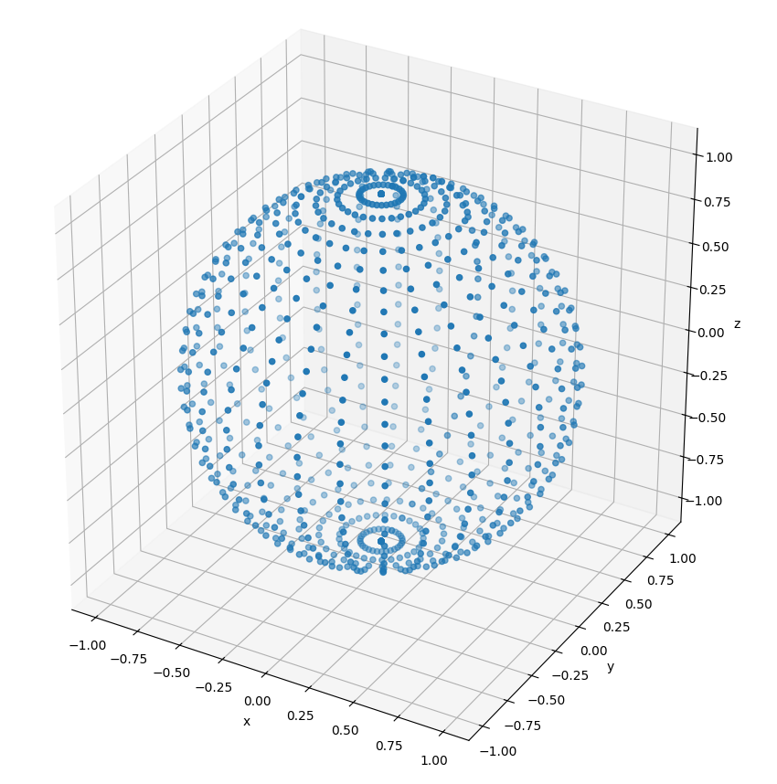
Run plot3d_sphere.py

Slide 33
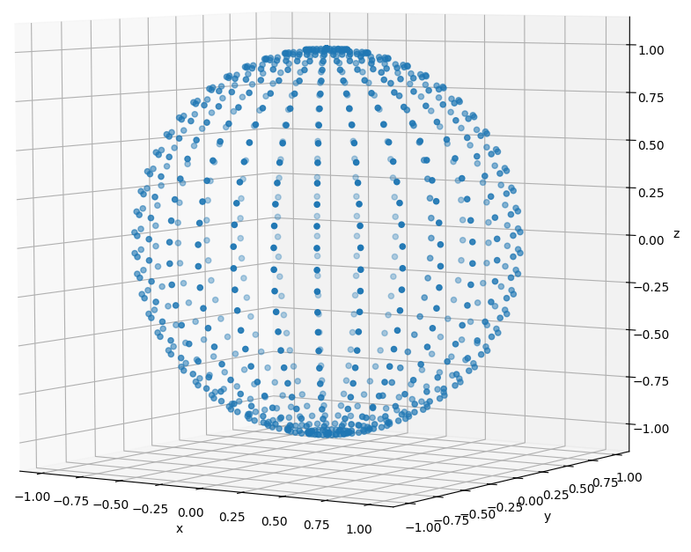
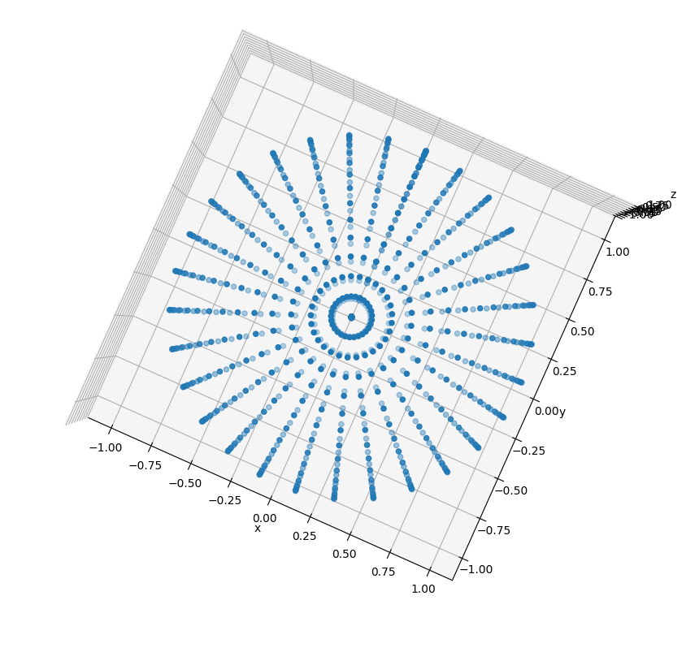
Run plot3d_sphere.py
$0≤v≤2π⟹$ toroidal (longitude)
Around the slice (horizontal)
$$u$$
$$R$$
$R_{t}$= radius of slice
$$v$$
$$R_{t}$$
$0≤u≤π⟹$ poloidal (latitude)
North to South Pole (vertical)

Slide 34
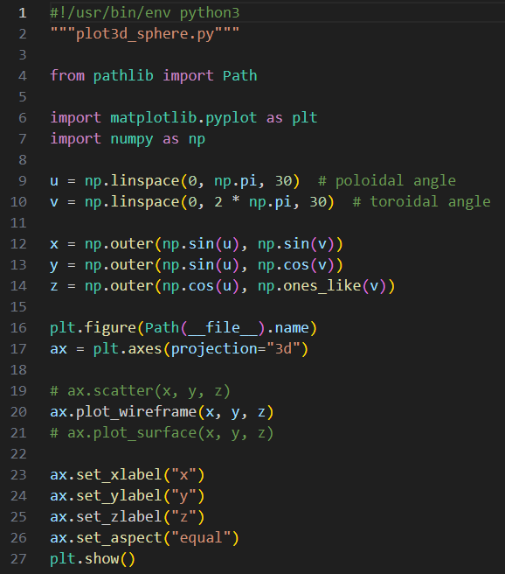
Edit plot3d_sphere.py
You must edit in this code
Comment out line 19
Uncomment line 20

Slide 35
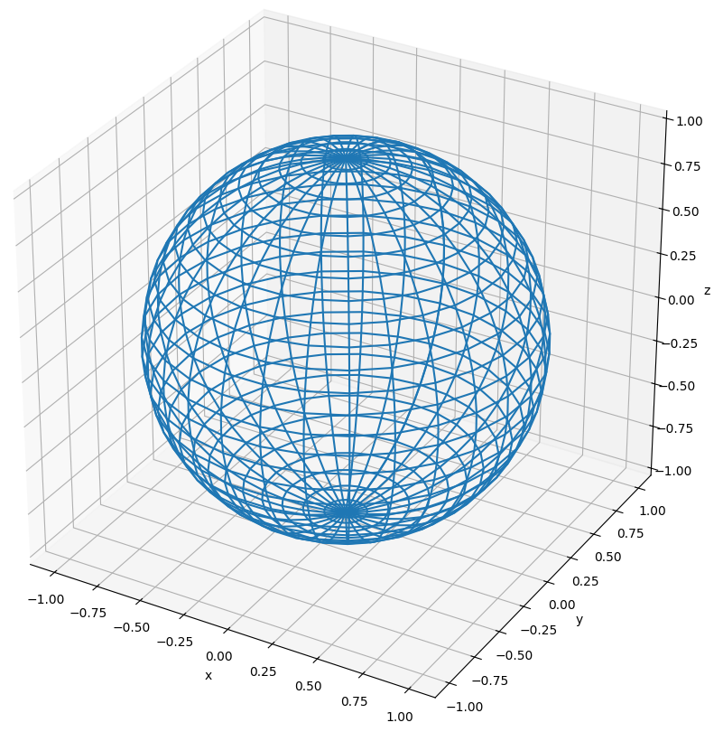
Run plot3d_sphere.py

Slide 36
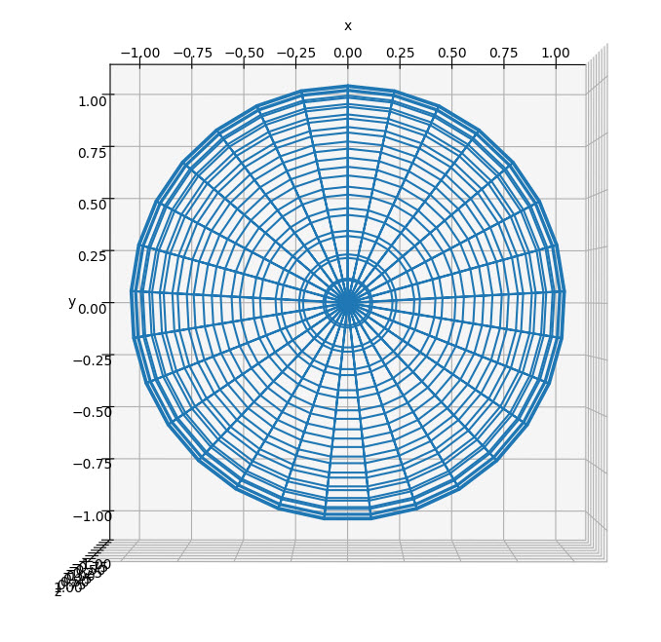
View plot3d_sphere.py
Top-Down
View

Slide 37
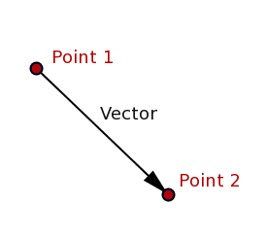
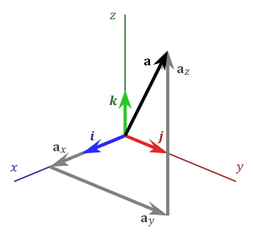
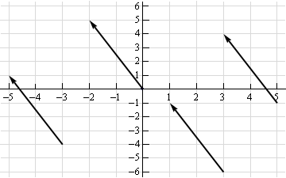
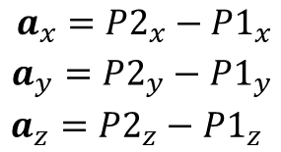
Real Vectors
$a_{x} a_{y} a_{z}$ are the components of
vector$\overset{⃑}{a}$
$$({P2}_{x},{P2}_{y},{P2}_{z})$$
A Magnitude & Direction
These four vectors are all the same!
$$({P1}_{x},{P1}_{y},{P1}_{z})$$

Slide 38
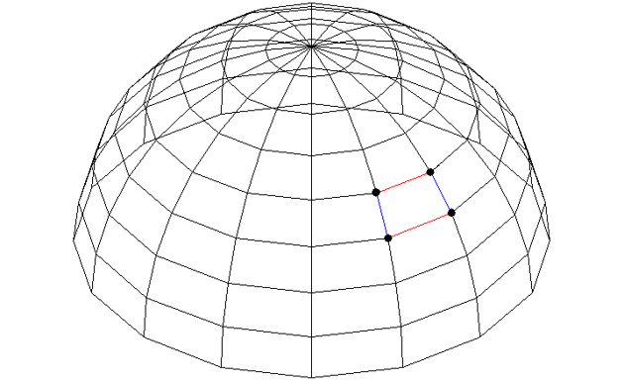
Backface Culling
How do we avoid drawing the facets which are on the back of the sphere?
$$\overset{⃑}{a}$$
⓿
❶
$$\overset{⃑}{b}$$
❷

Slide 39
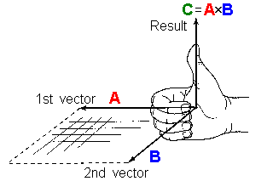
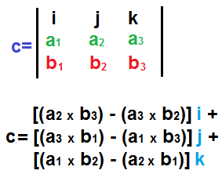
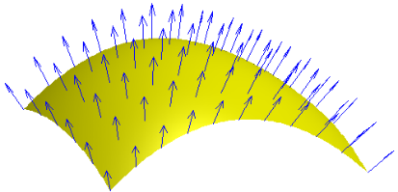
Vector Cross Product
$$\vec{c}=\vec{a}×\vec{b}$$
$$\vec{c}=$$
$$\vec{a}$$
$$\vec{c}=$$
$$\vec{b}$$
The cross product of two vectors is another vector $c$ which is perpendicular to both vectors $a$ and $b$

Slide 40
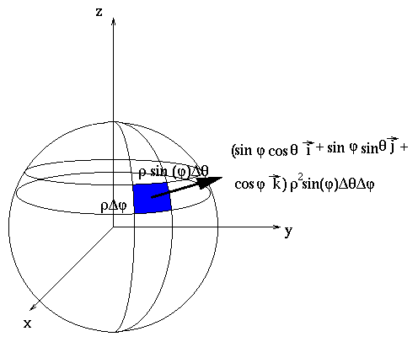
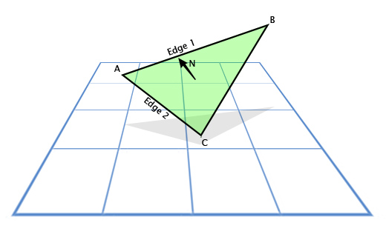
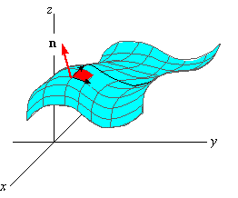
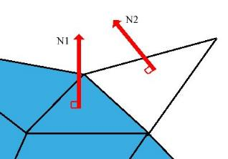
Every Facet has a Surface Normal Vector

Slide 41
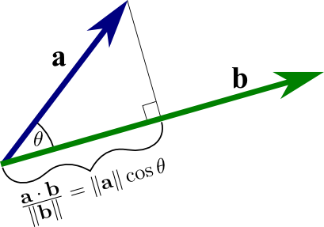
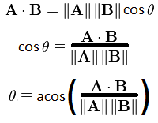
Vector Dot Product
The dot product gives the angle between two vectors

Slide 42
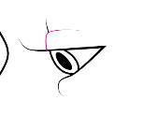



Backface Culling and Facet Shading
$$\vec{n}$$
Camera / Eye Location
$$θ$$

Slide 43

Edit plot3d_sphere.py
You must edit in this code
Comment out line 20
Uncomment line 21

Slide 44

Run plot3d_sphere.py
Left-click and drag to rotate the plot

Slide 45

Run plot3d_sphere.py

Slide 46


Modelling a Torus
Your scientist would like to begin modelling the electromagnetic field around a toroidal coil carrying AC current
The first step will be defining and drawing a 3D torus using a modified version of the spherical coordinate system
The red arrow points in the poloidal direction and the blue arrow points in the toroidal direction
A sphere and a torus are not homeomorphic: unlike a sphere, a torus needs two radii to fully describe it

Slide 47

Modelling a Torus
Note: $0≤u≤2π$
$$R_{t}=Radius of Torus$$
$$R_{c}=Radius of Cross Section$$
$$u$$
$$(z)$$
$$R_{c}$$
$$R_{t}$$
$$x=\left[R_{t}+R_{c}\sin{u}\right]\cos{v}$$
$$y=\left[R_{t}+R_{c}\sin{u}\right]\sin{v}$$
$$z=R_{c}\cos{u}$$

Slide 48

Modelling a Torus
Note: $0≤u≤2π$
$$(x,y)$$
$$v$$
$$R_{t}$$
$$R_{c}$$
$$x=\left[R_{t}+R_{c}\sin{u}\right]\cos{v}$$
$$y=\left[R_{t}+R_{c}\sin{u}\right]\sin{v}$$
$$z=R_{c}\cos{u}$$

Slide 49

Open plot3d_torus.py
DO NOT edit
this code
①
②
③
④
⑤
⑥
⑦
⑧

Slide 50

Run plot3d_torus.py

Slide 51

Edit plot3d_torus.py
You must type in this code
Comment out line 23
rcount = Max # of rows to plot
ccount = Max # of columns to plot
①
Uncomment line 24

Slide 52

Run plot3d_torus.py

Slide 53

Open plot3d_surface.py
DO NOT edit
this code
①
$$f\left(x,y\right)=\sin\left(\sqrt{x^{2}+y^{2}}\right)$$
②
③
NumPy Meshgrid From Zero To Hero
④
⑤
⑥
⑦
⑧
10 total tick marks, linearly spaced

Slide 54


Run plot3d_surface.py
$$f\left(x,y\right)=\sin\left(\sqrt{x^{2}+y^{2}}\right)$$

Slide 55


View plot3d_surface.py

Slide 56

The Gradient Operator
A differential operator
Scalar Field → Vector Field
Vector Field → Scalar Field
Vector Field → Vector Field

Slide 57


The Gradient Operator
White is lower, Black is higher
Direction of steepest ascent
The gradient, represented by the blue arrows, denotes the direction of the most positive change in a scalar field

Slide 58

The Gradient Operator
https://numpy.org/doc/stable/reference/generated/numpy.gradient.html

Slide 59

Open plot3d_gradient.py
DO NOT edit
this code
①
$$f\left(x,y\right)=\sin\left(\sqrt{x^{2}+y^{2}}\right)$$
We only want gradient arrows drawn every 5 data points on the fine grid
②
③
④
⑤
⑥
⑦
⑧
⑨
⑩
Derivatives are rise over run $=\frac{∂y}{∂x}$ so the $ⅆy$ vector is returned first in the tuple

Slide 60

Run plot3d_gradient.py
Why are there no arrows near these white circles?
Direction of steepest ascent
How does the 1st derivative of the function affect the length of the quivers?

Slide 61
Session 17 – Now You Know…
How to draw 3D images with matplotlib
How to create vertices and facets to manually build wireframe and surface plots
How to create vectors of 3D coordinates using radial angles and outer products and then letting matplotlib automatically connect nearby vertices, so it can render wireframes and surface plots
Vector algebra, including inner (dot) product and cross product, can be used to enable back-face culling and facet shading
Two shapes that are not homeomorphic may require additions to the parametric equations (inserting another radius or tracking another angular measure) such as drawing a torus vs. a sphere

Slide 62

Task 17
Update the Python file called plot3d_cylinder.py that uses matplotlib to draw a shaded red cylinder of radius 10 and height 50
The cylinder should be aligned along the z-axis

